Slide 1
Lecture 19-21
Data Structures
Presented By:
Marina Gul

Slide 2
Topics to be covered
Recap of the previous lecture
Recursion
Trees

Slide 3
Calling Methods
Methods can call other methods
Can a method call itself?
Yes! This is called a recursive method (function)
“A method within a method”

Slide 4
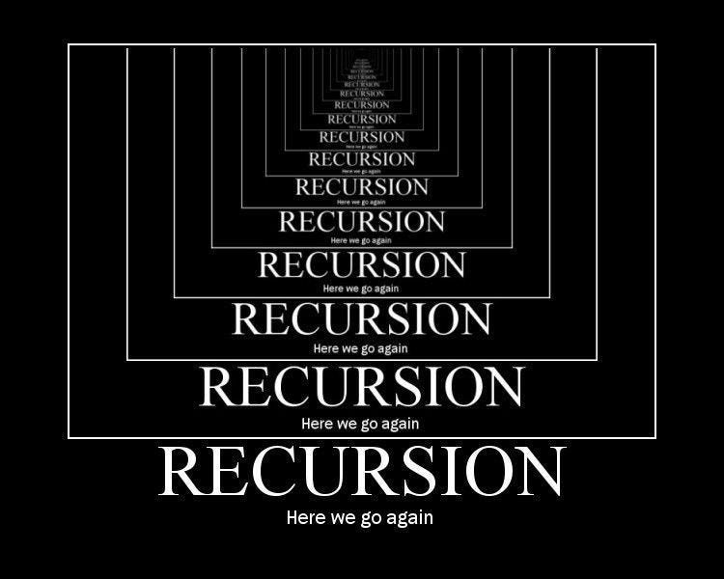

Slide 5
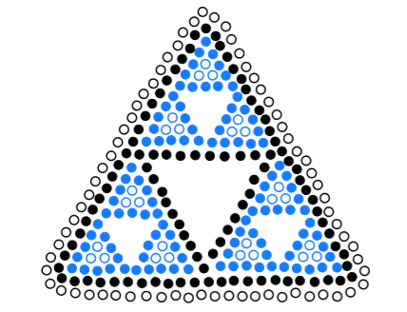
What is recursion?
Two approaches of implementing repetitions:
Iterations (loops like for, while etc.)
Recursion
We already know what iterations are.
Recursion is a repetitive process in which an algorithm calls itself.
Usually implemented by making a function which calls itself

Slide 6
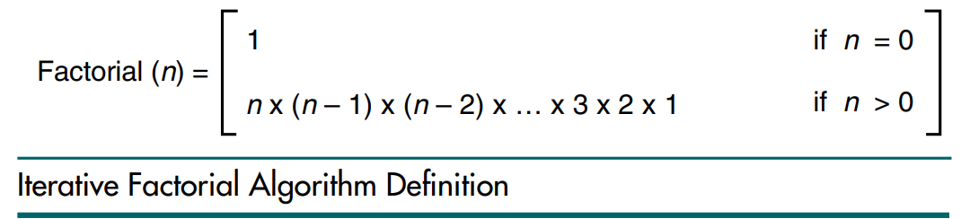
Example
Iterative Factorial Function
factorial(n){
prod = 1
for i in range(1,n):
prod *= i
return prod
}
print(factorial(5))

Slide 7
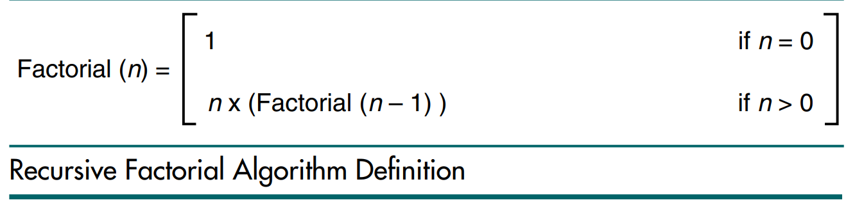
Example
Recursive Factorial Function
factorial(n){
if n==0 or n == 1:
return 1
else:
return n* factorial(n-1)
}
print(factorial(4))
4!=4*3!=4*3*2!=4*3*2*1!

Slide 8
How does recursion work?
Factorial(4)
4*Factorial(3)
3*Factorial(2)
2*Factorial(1)
2*1
3*2
4*6
24

Slide 9
Example 01
void test(int n) {
if (n > 0) {
System.out.println(n);
test(n-1);
System.out.println(n);
}
}
Trace the execution of test(4)

Slide 10
Example 02
void test(int n) {
if (n > 0) {
System.out.println(n);
test(n-1);
System.out.println(n);
}
}
Trace the execution of test(-4)

Slide 11
Typical parts of a recursive function
There are two parts
Base case
Recursive case
Base case
Responsible for returning of value
Recursive case
Responsible for recursive call

Slide 12
Example
factorial(n){
if n==0 or n == 1:
return 1
else:
return n* factorial(n-1)
}
print(factorial(5))
Base case
Recursive case

Slide 13
Limitations of Recursion
Recursion works best when
the algorithm uses a data structure that naturally supports recursion.
Example: tree data structure
or
The algorithm is naturally suited to recursion.
Example: binary search algorithm

Slide 14
When you should not use recursion?
If the answer to any of the following questions is No:
Is the algorithm or data structure naturally suited to recursion?
Is the recursive solution shorter and more understandable?
Does the recursive solution run within acceptable time and space limits?

Slide 15
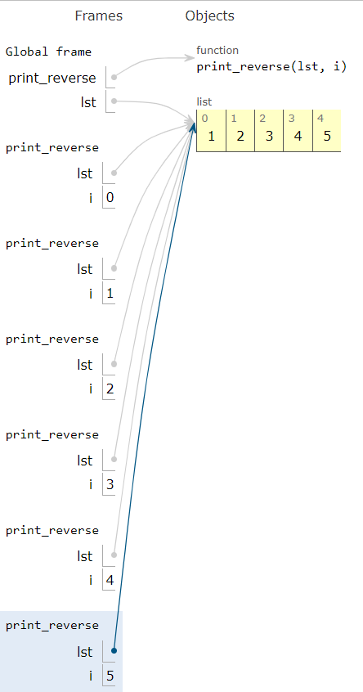
Examples of Recursion
Print a list in reverse
Output
5 4 3 2 1
print_reverse(list, i){
if i==len(list):
return
print_reverse(list, i+1)
print(list[i], end=" ")
}
list = [1,2,3,4,5]
print_reverse(list, 0)

Slide 16
Examples of Recursion
Print a list in reverse
Stack winding
print_reverse(lst, 5)
print_reverse(lst, 4)
Function call stack
print_reverse(lst, 3)
print_reverse(lst, 2)
print_reverse(lst, 1)
print_reverse(lst, 0)

Slide 17
Examples of Recursion
Print a list in reverse
Stack unwinding
print_reverse(lst, 5)
print_reverse(lst, 4)
Function call stack
print_reverse(lst, 3)
print_reverse(lst, 2)
print_reverse(lst, 1)
print_reverse(lst, 0)

Slide 18
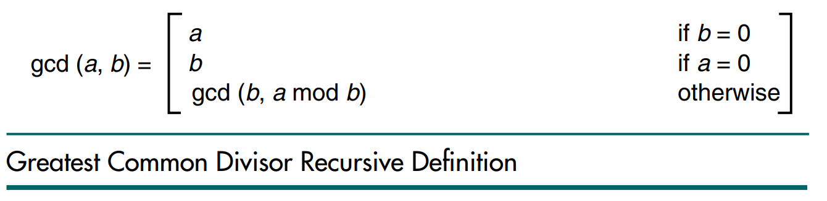
Example Exercise
Greatest Common Divisor (GCD)

Slide 19
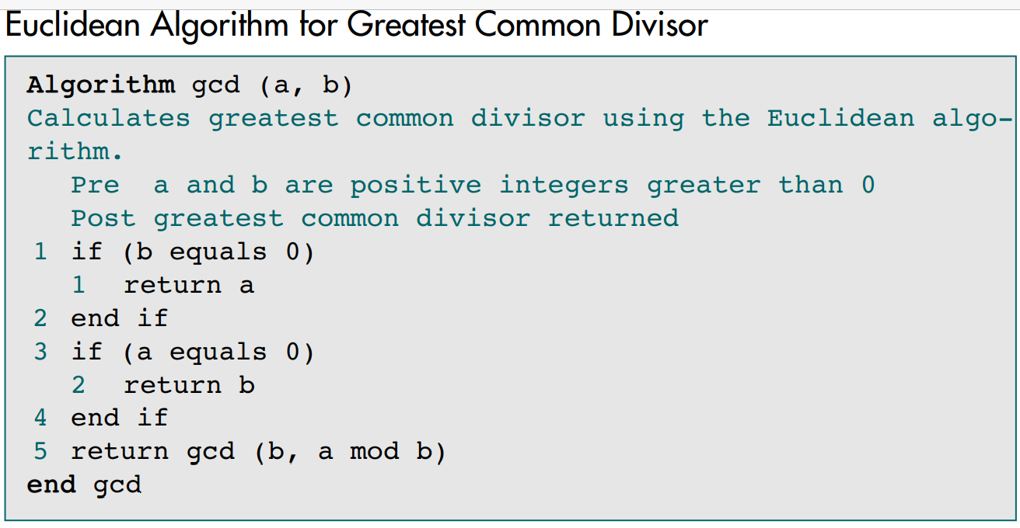
Example Exercise
Notes:
GCD(12,33)

Slide 20
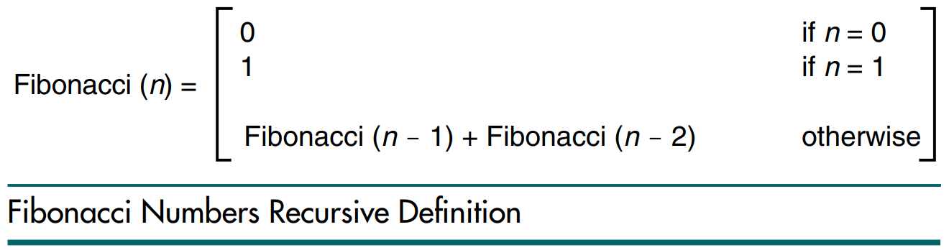
Example Exercise
Fibonacci numbers

Slide 21
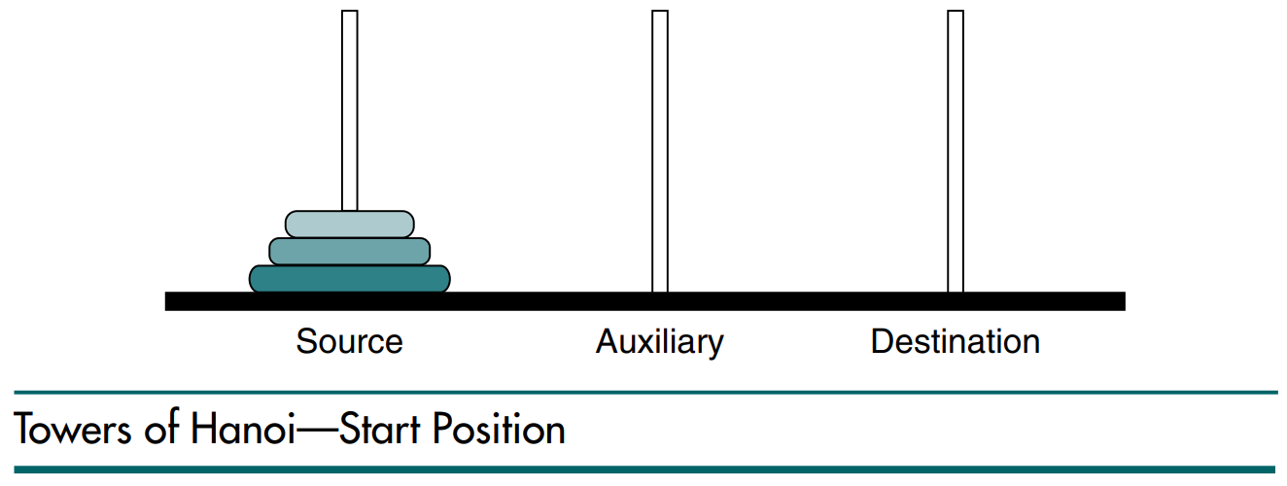
Example
Towers of Hanoi Problem
Given a set of disk and a few needles
Constraints
Only one disk could be moved at a time. A larger disk must never be stacked above a smaller one.
One and only one auxiliary needle could be used for the intermediate storage of disks.

Slide 22
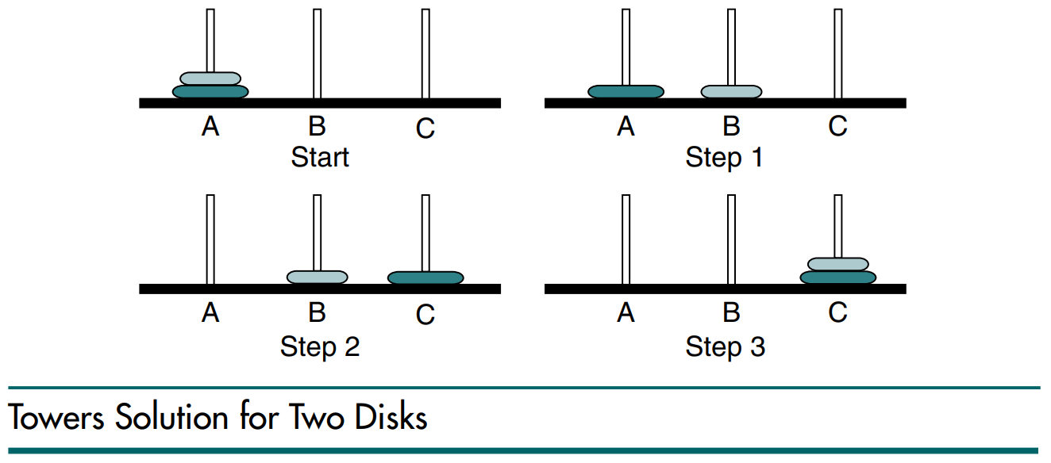
Solution of Tower of Hanoi with 2 disks

Slide 23
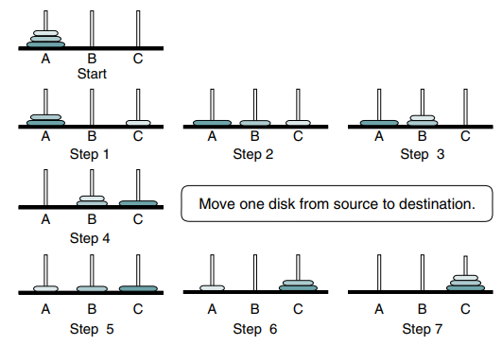
Solution of Tower of Hanoi with 3 disks

Slide 24
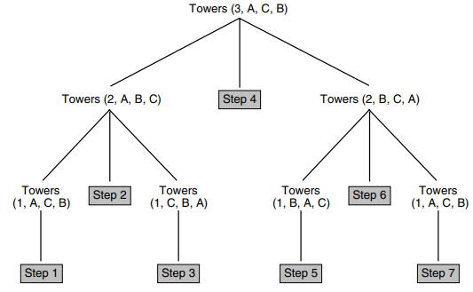
Solution of Tower of Hanoi with 3 disks

Slide 25
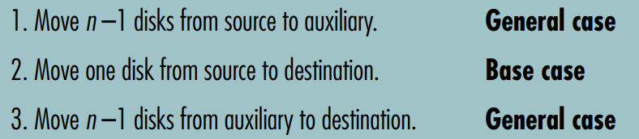
Generalized Solution
Call Towers (n - 1, source, auxiliary, destination)
Move one disk from source to destination
Call Towers (n - 1, auxiliary, destination, source)

Slide 26
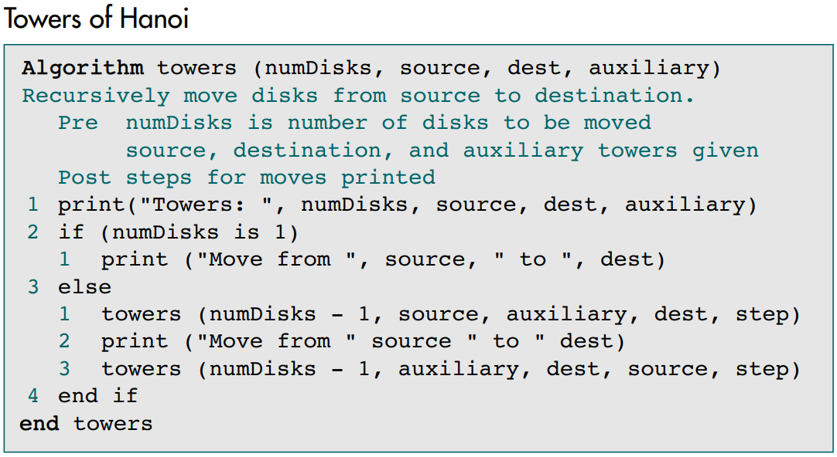
Solution

Slide 27
Recap of the Lecture
Recursion is a repetitive process in which an algorithm calls itself.

